Slide 1
Capstone Engagement
Assessment, Analysis, and Hardening of a Vulnerable System
Report Prepared by Yekaterina Alenicheva

Slide 2
Table of Contents
This document contains the following sections:
01
Network Topology
02
Red Team: Security Assessment
03
Blue Team: Log Analysis and Attack Characterization
Hardening: Proposed Alarms and Mitigation Strategies
04

Slide 3
Network Topology
3

Slide 4
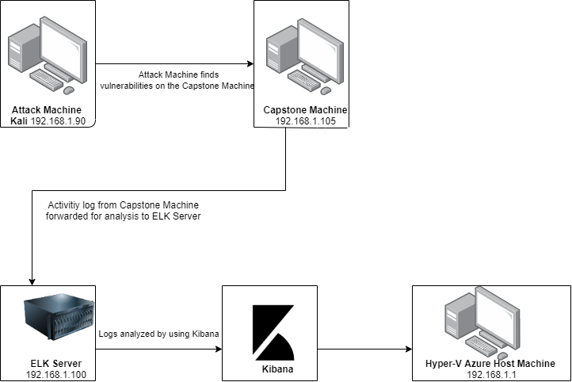
Network Topology
Network
Address Range:
192.168.1.0/24
Netmask: 255.255.255.0
Gateway: 192.168.1.1
Machines
IPv4: 192.168.1.90
OS: Linux 2.6.32
Hostname: kali
IPv4: 192.168.1.105
OS: Linux
Hostname: Capstone
IPv4: 192.168.0.100
OS: Linux
Hostname: ELK
IPv4: 192.168.1.1
OS: Windows 10
Hostname:
Azure Hyper-V ML-RefVm-684427
[Insert Here]
Use draw.io to create a diagram of the network.
Add your diagram to this slide and fill out the data in the sidebar.

Slide 5

Red Team
Security Assessment
5

Slide 6
Recon: Describing the Target
Nmap identified the following hosts on the network:
Hostname | IP Address | Role on Network
Kali | 192.168.1.90 | Attack Machine
Capstone | 192.168.1.105 | Victim Machine
ELK Server | 192.168.1.100 | Monitoring Machine running Kibana
Hyper-V Azure machine | 192.168.1.1 | Host Machine

Slide 7
Vulnerability Assessment
The assessment uncovered the following critical vulnerabilities in the target:
Vulnerability | Description | Impact
Port 80 open with public access CVE-2019-6579 | Open and unsecured access to anyone attempting entry using Port 80 | Sensitive files and folders easily accessible.
Accessible Files/simple username/weak password and hashed passwords | Root directory contains sensitive files that is accessible to the server’s users. In addition, simple usernames, weak and hashed passwords. | This allowed to access company’s website with IP on Port 80 via web browser and view sensitive folders. System access can be discovered by social engineering techniques. Hashed passwords can be easily cracked via online tools.
Ability to discover password by Brute Force Attack CVE-2019-3746 | Method of using numerous username and password combination to access a system. | This allow to access the system with password wordlist such as rockyou.txt by command line tool hydra.
WebDAV Vulnerability/ LFI Vulnerability | Exploit WebDAV with custom payload and upload a php shell is possible. | Allow attacker to exploit by uploading php shell into file system.

Slide 8
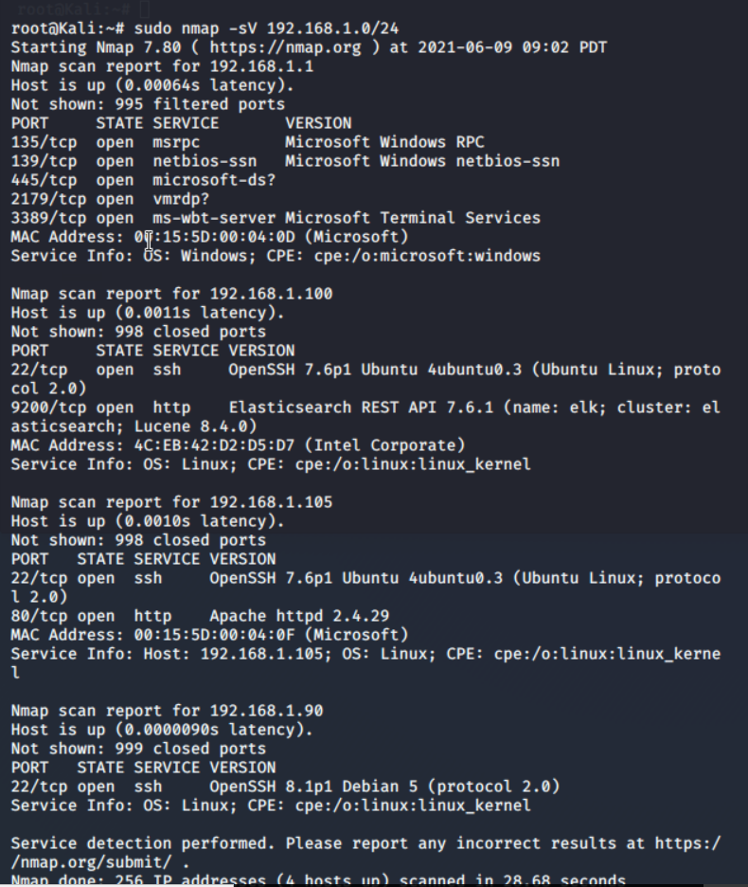
Exploitation: Open Port 80
01
02
03
Tools & Processes
Used nmap to scan for any open ports and services in the network.
Achievements
Scan report idenfitied IP adress 192.168.1.105 had open port 80, which we were able to access via web browser and view the content of the folders.

Slide 9
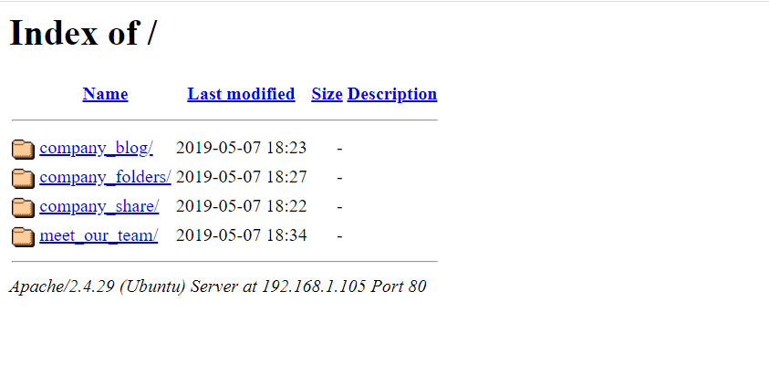
Exploitation: Accessible Files
01
02
03
Tools & Processes
Use open Port 80 to access the web browser to see if there any important information.
Achievements
Accessing the files gave us insights on the type of files, their users, and the location of sensitive files. As a result Ashton managing secret files.

Slide 10
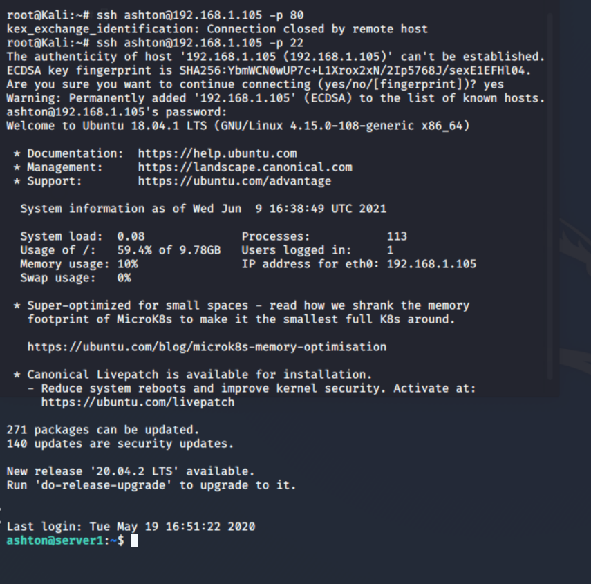
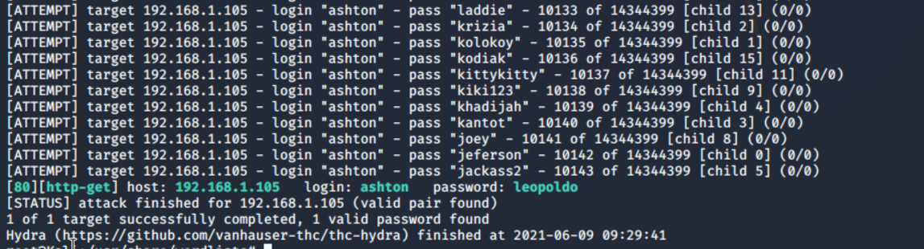
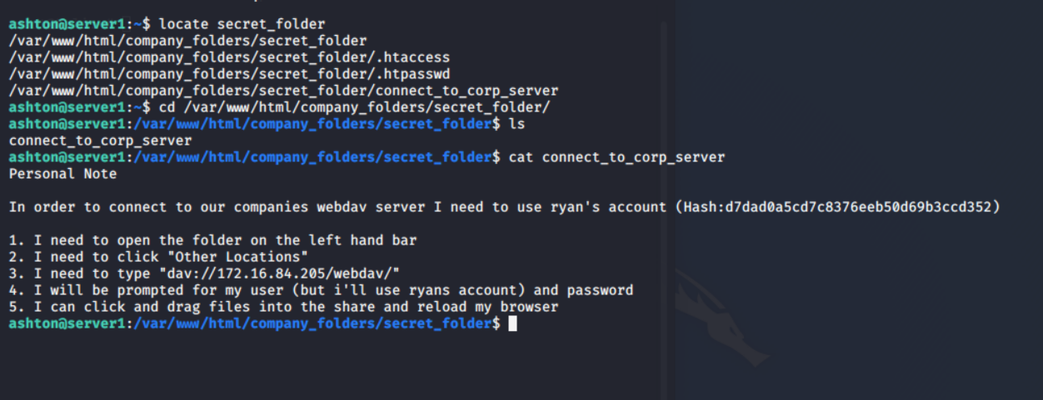
Exploitation:Brute Force Password
01
02
03
Achievements
The Brute Force was successful and revealed Ashton’s password: leopoldo
User access achieved.
Tools & Processes
To Brute Force Ashton’s password we access the wordlist directory rockyou.txt and used tool Hydra to crack the password.
Command: hydra –l ashton –P rockyou.txt.gz –s 80 –f –vV 192.168.1.105 http-get /company_folders/secret_folder

Slide 11
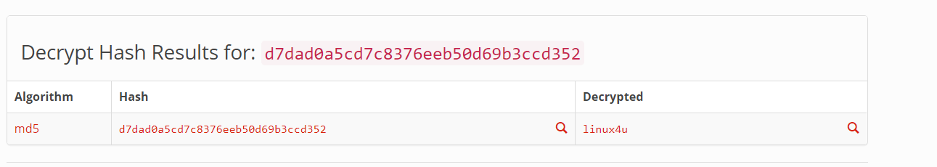
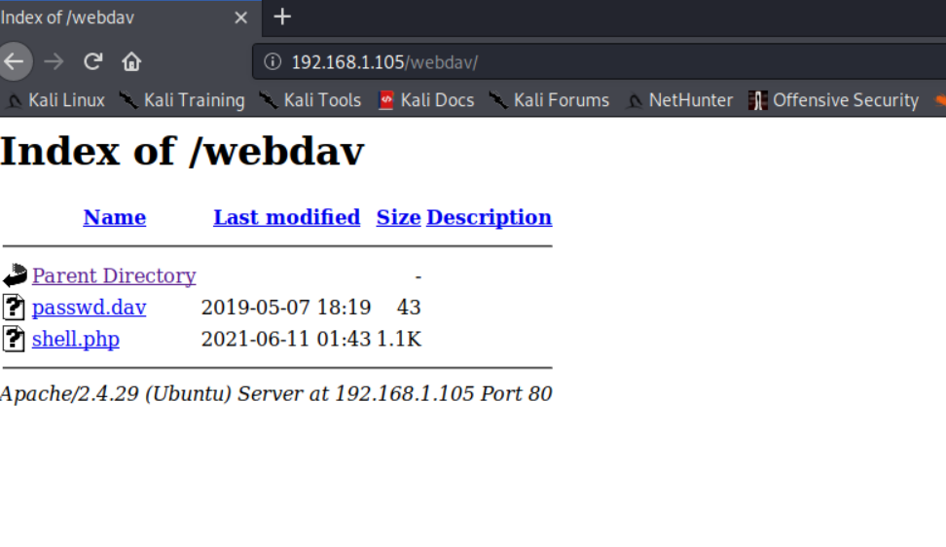
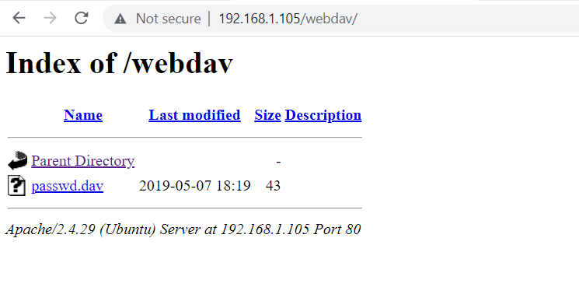
Exploitation: Hashed Password
01
02
03
Achievements
The cracked password was linux4u which allow to access Ryan’s account and upload a shell script to attack.
Tools & Processes
I used online md5 cracker crackstation.net to crack the hashed passowrd for ryan’s account in order to access the webdav.

Slide 12
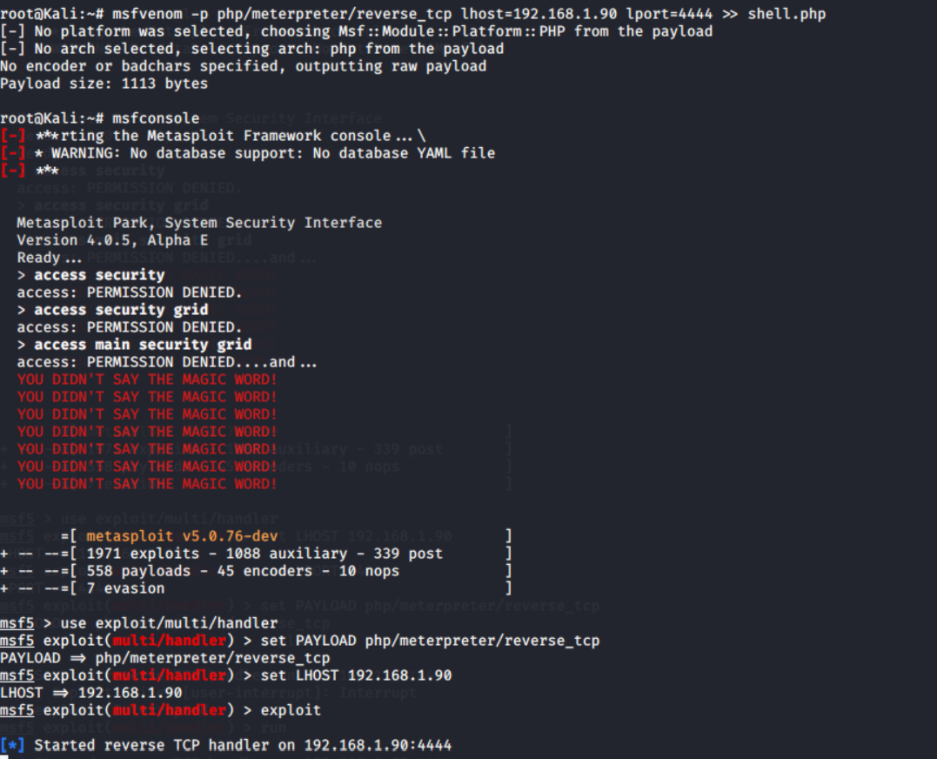
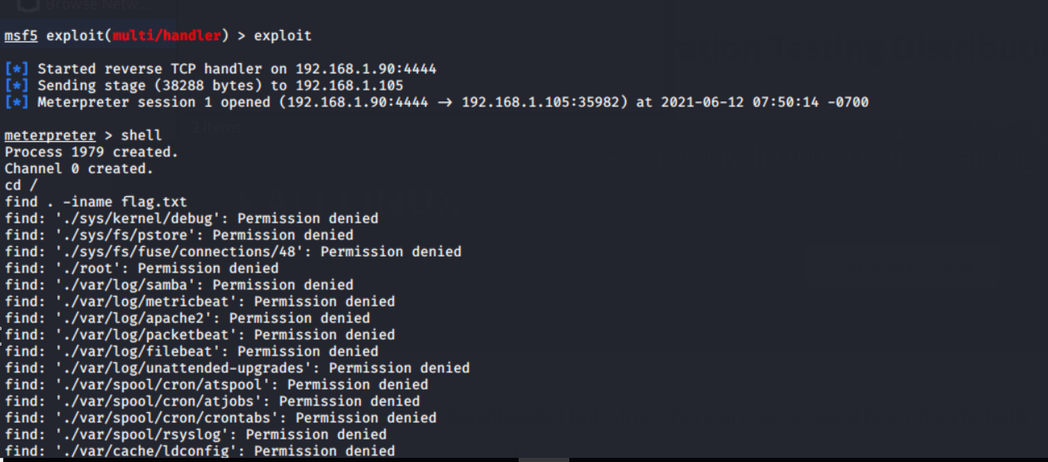
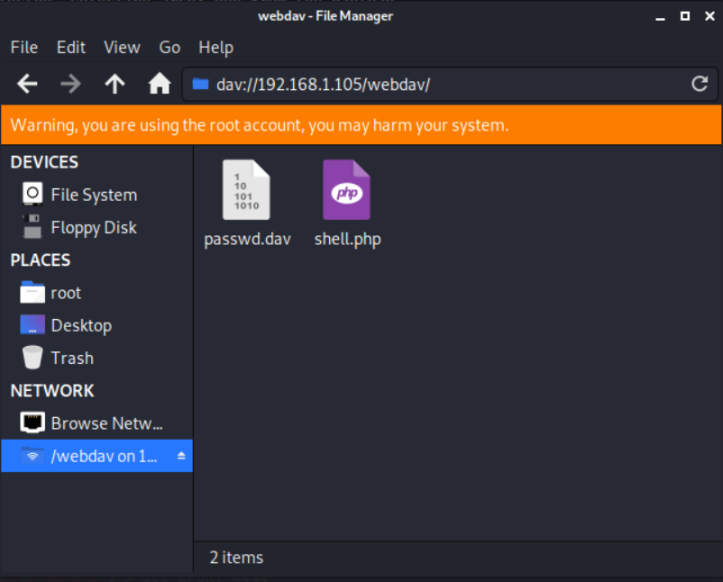
Exploitation: LFI Vulnerability
01
02
03
Tools & Processes
I used msfvenom to customize php payload, msfconsole to exploit, and meterpreter to establish a shell session on victim machine.
Achievements
Using multi/handler I was able to gain access to victim’s machine shell, upload php exploit to file system, and later obtain a secret file.

Slide 13

Blue Team
Log Analysis and Attack Characterization
13

Slide 14
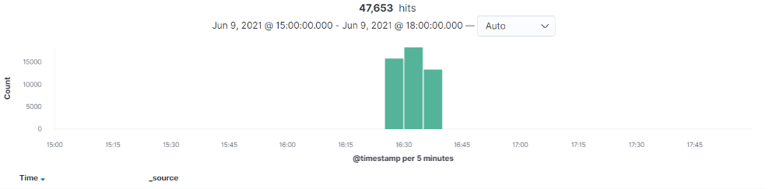
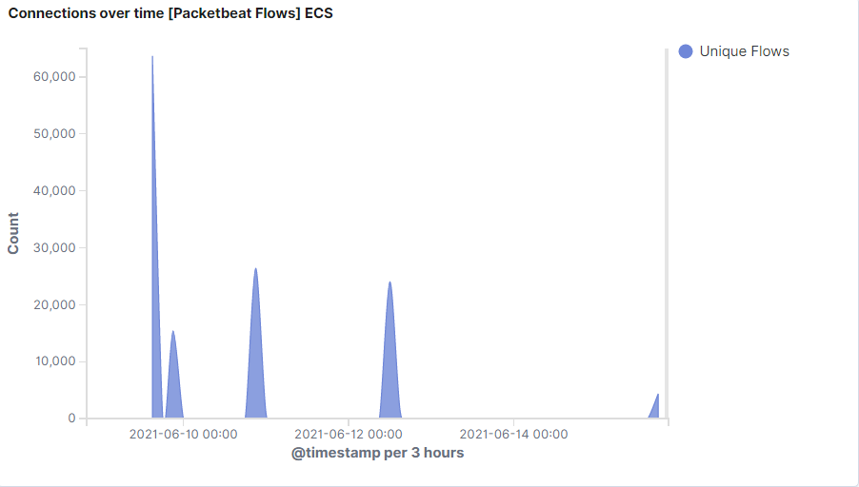
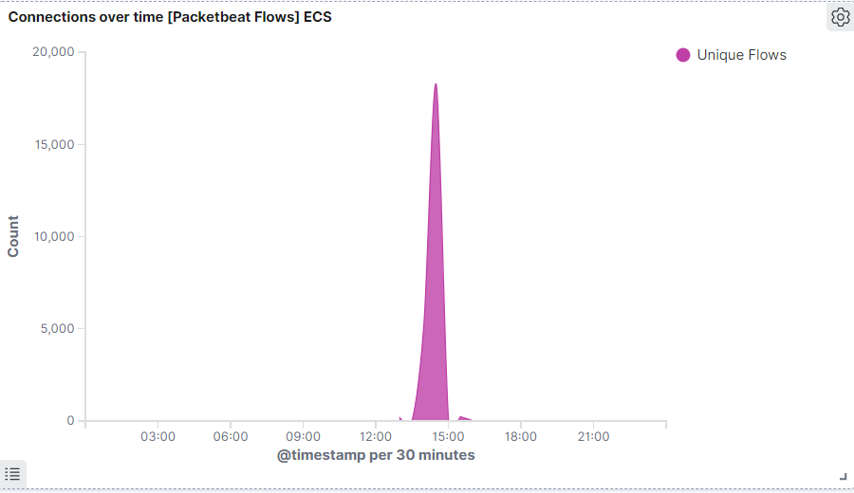
Analysis: Identifying the Port Scan
The port scan started on June 9, 2021, at 15:00 and continue until 21:00
63,697 connections occurred at the peak; the source IP was 192.168.1.90
Increased peaks indicates port scanning attempts
47,653 number of hits occurred between 15:00 and 18:00

Slide 15
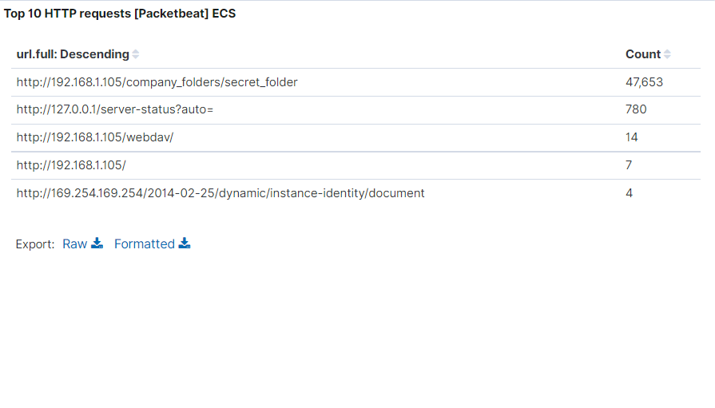
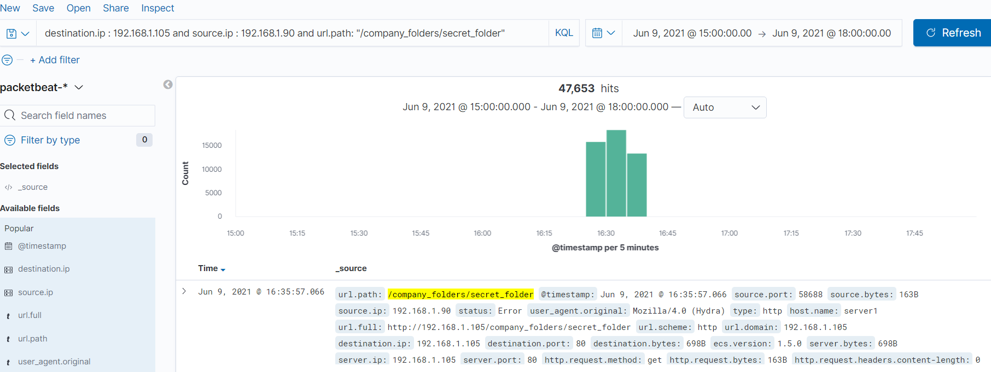
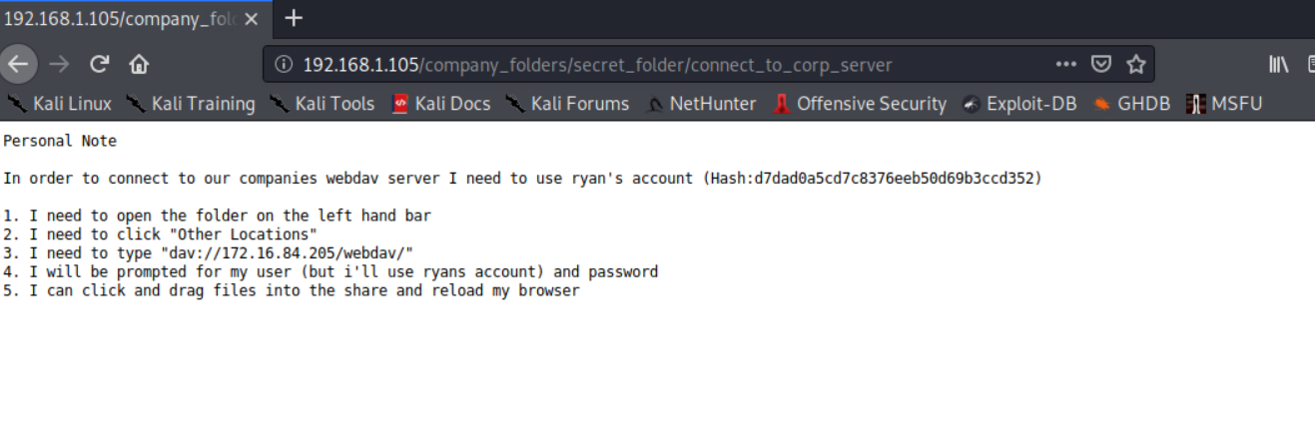
Analysis: Finding the Request for the Hidden Directory
The request started on June 9,2021 at 15:00
47,653 requests were made to access the secret _folder
The secret_folder contained hash which I use to gain access to the system using Ryan’s credentials
The secret_folder also allowed to upload php payload to exploit victim’s machine and later establish connection to execute further vulnerabilities

Slide 16
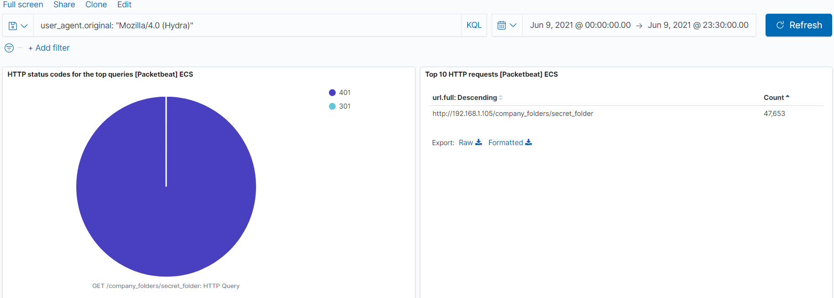
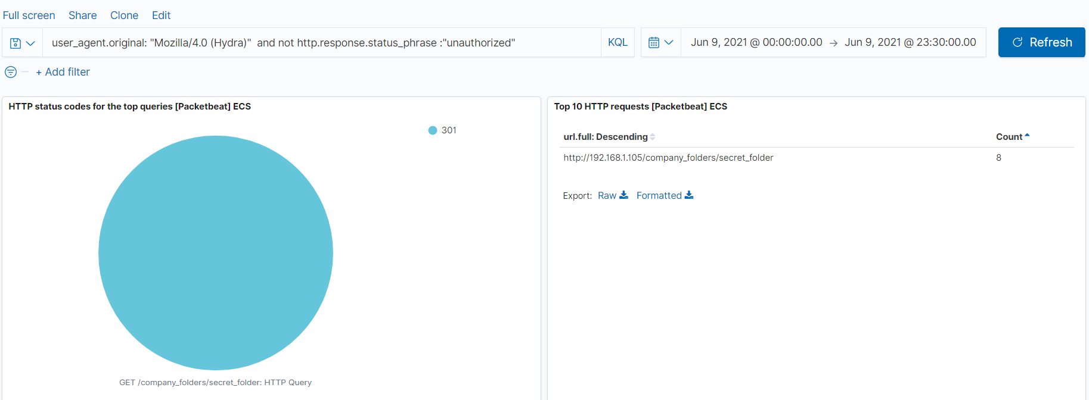
Analysis: Uncovering the Brute Force Attack
47,653 requests were made in the brute force attack on June 9, 2021
Out of 47,653 requests, only 8 were successful in the attempt to brute force password

Slide 17
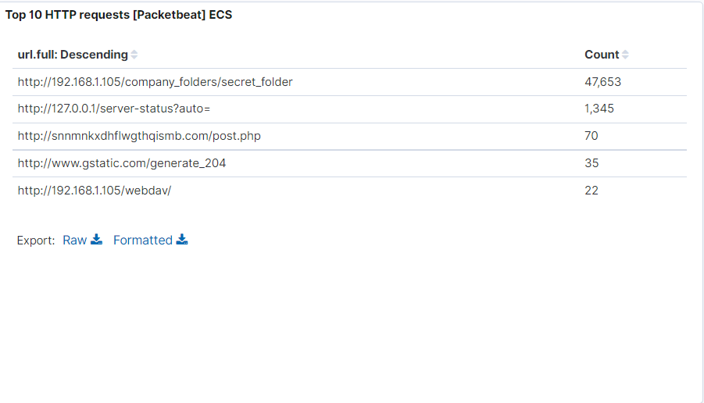
Analysis: Finding the WebDAV Connection
22 requests were made to access the /webdav directory on the day of the attack
The requests were made for the passwd.dav and shell.php by red team’s shell attack.

Slide 18
Blue Team
Proposed Alarms and Mitigation Strategies
18

Slide 19
Mitigation: Blocking the Port Scan
Set up the alarm in firewall where the default value of port scans per second for the same IP address during the threshold period is 10.
Proactive scanning to identify which ports are at risk
Determine which ports needs to be open, and block everything else, configure firewall rules to allow an deny accordingly.
Robust monitoring practice to detect anomalies.

Slide 20
Mitigation: Finding the Request for the Hidden Directory
Set the alert with the number of threshold of maximum 5 attempts per hour that would trigger the alert if the threshold is exceeded. Set high severity for the alert.
Set up root directory and Access Control List for access rights and privileges
Limit user input and input validation
Encryption of all files and folders that contains valuable data
Regularly back up files and folders
Possibly remove the directory from the server

Slide 21
Mitigation: Preventing Brute Force Attacks
Set the alert that will trigger HTTP 401 Unauthorized error. The maximum threshold is 10 error in a minute.
Set the severity level to default value High
Set the alert that will trigger Hydra name in the user_agent.original value.
Configure Brute-force protection
Block Brute force logins by blocking attacking IP addresses.
Enable Account Lockout.
Enable 2FA, configure common login IP addresses and SSH IP address whitelist.
Change SSH port and define users that can log in in the ssh service
Limit access using iptables rules
Port knocking

Slide 22
Mitigation: Detecting the WebDAV Connection
Set whitelist on trusted IP addresses only
Activate alert that will trigger IP addresses outside of the trusted ones
Set the alert with threshold maximum of 5 HTTP put requests are made.
Set the firewall rule that will control access to directory and assign permissions
Encrypt all communication with SSL and allow only http or https traffic.
Use strong password policy which require update passwords on regular basis

Slide 23
Mitigation: Identifying Reverse Shell Uploads
Set the alert that will trigger when any traffic will attempt to access port 4444. The threshold for the alert is 1.
Set the alert for any attempt to upload files to WebDAV folder, particularly php files.
Require authentication to upload files
Store uploaded files in a location not accessible from the web
Use a file type detector to define valid files
The file names and extensions of uploaded files must be change
Removing extensions minimize the risk to upload the files

